Slide 1
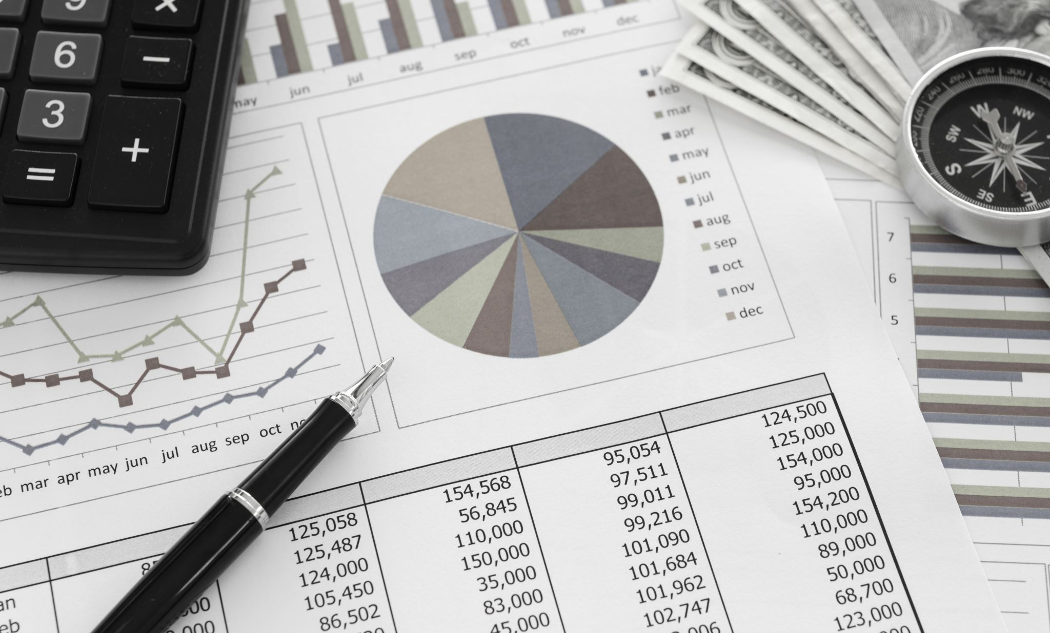
Personal Budgeting
A Guide to Managing Your Finances

Slide 2
Introduction
Personal budgeting is a crucial aspect of financial management. It involves planning and tracking your income and expenses to achieve financial stability and meet your financial goals.

Slide 3
Benefits of Budgeting
1. Financial Control: Budgeting helps you take control of your finances.
2. Goal Achievement: It enables you to work towards and achieve your financial goals.
3. Emergency Planning: Budgeting prepares you for unexpected expenses and emergencies.

Slide 4
Budgeting Tips
Track Your Expenses: Keep a record of all your expenditures.
This involves creating a detailed record of all your expenses, both fixed (like rent, utilities) and variable (such as groceries, entertainment). By tracking your spending, you gain a clear understanding of where your money is going. Use tools like budgeting apps or spreadsheets to categorize and analyze your expenditures. This process helps identify areas where you can cut back or make adjustments to align with your financial goals.
2. Set Realistic Goals: Establish achievable financial objectives.
It's crucial to set clear and achievable financial goals. These could include paying off debt, saving for a vacation, or building an emergency fund. The key is to make sure your goals are realistic and attainable based on your income and current financial situation. Break down larger goals into smaller, more manageable milestones. This not only makes them more achievable but also provides a sense of accomplishment as you reach each milestone.

Slide 5
Budgeting Tips
3. Emergency Fund: Save for unforeseen circumstances.
An emergency fund acts as a financial safety net for unexpected expenses such as medical bills, car repairs, or job loss. Aim to set aside three to six months' worth of living expenses in a separate savings account. This fund provides a cushion, reducing the need to rely on credit cards or loans during emergencies. Regularly contribute to your emergency fund, even if it's a small amount each month, to gradually build a financial buffer.
4. Review Regularly: Periodically assess and adjust your budget.
A budget is not a static document; it should evolve with changes in your financial situation. Regularly review your budget, preferably on a monthly basis, to ensure that you are staying on track with your financial goals. Evaluate your spending patterns, income, and savings. Adjust your budget as needed, taking into account any changes in your life, such as a salary increase, new expenses, or shifts in financial priorities. This ongoing assessment helps you stay flexible and proactive in managing your finances effectively.

Slide 6
Conclusion
Personal budgeting is a powerful tool for financial success. By implementing effective budgeting strategies, you can take charge of your financial future and achieve your desired financial outcomes.

